Slide 1
Solving for X – Word
Kathryn Johnson

Slide 2

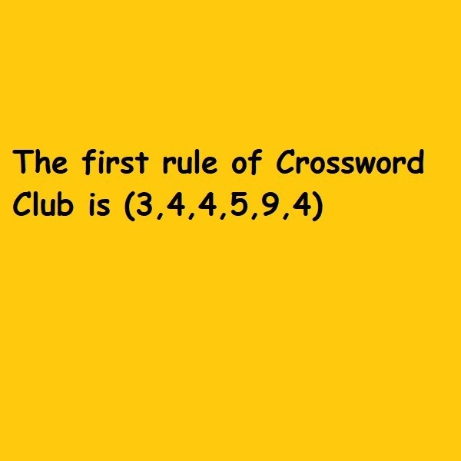
Why Crosswords?
NYT crossword statistics are abundant, but general
Personalized statistics are scarce
Notes:
There are whole websites devoted to analyzing the crossword, but it’s really hard to get insights on your personal data. I’m a big crossword nerd. I do the NYT crossword every day and I have several years of data just waiting to be analyzed.

Slide 3







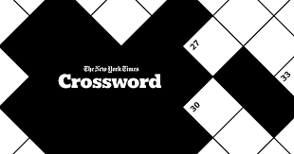

Technologies
Notes:
You can see the technologies I used here, I mostly want to highlight that I used Selenium to scrape the NYT website for 5 years of my daily puzzle data. For each puzzle I scraped the date, day of the week, Solve time, constructor, and the clues

Slide 4
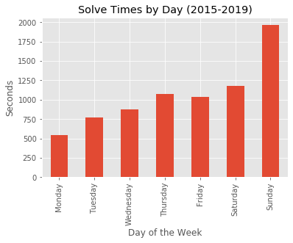
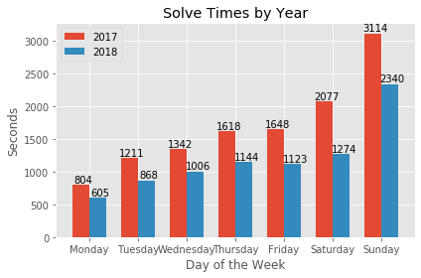
Solve Times Broken Down
Notes:
When I got my data I was so excited to start digging into it. Conventional wisdom is that Mondays are the easiest and crosswords get harder through the week, with Saturday being the hardest. Sundays are the largest puzzles and expect the longest solve times. There is an interesting discrepancy here that my Thursday times are worse than my Friday times, more on that later if I have time. I also broke out two years for comparison on the right, which I broke down further in my scientific test.

Slide 5
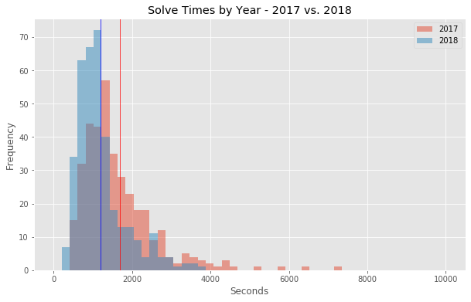
Did I Really Improve?
Null Hypothesis: There is no significant difference in average solve times between 2017 and 2018
Alternative Hypothesis: There is a significant difference in average solve times between 2017 and 2018
p-value: 1.9166e-12
Reject the Null Hypothesis
Notes:
Comparing year to year

Slide 6
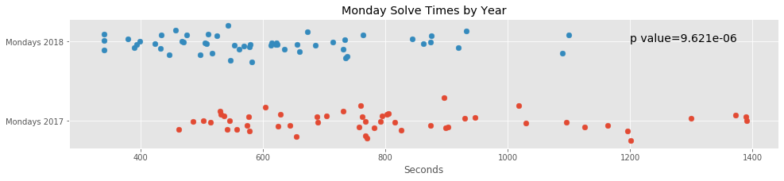
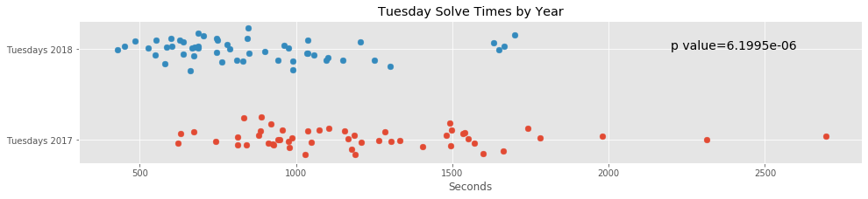
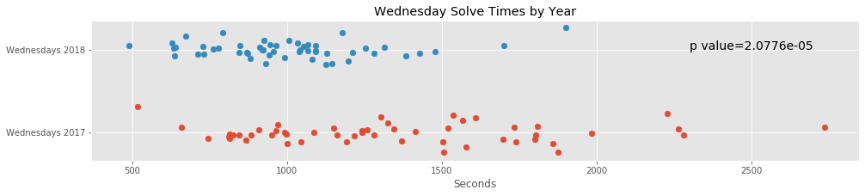
Breaking the Data Down by Day

Slide 7
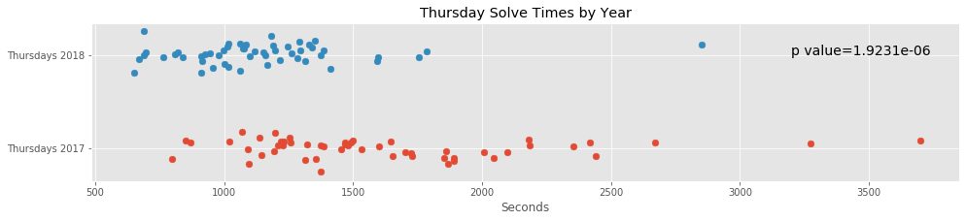
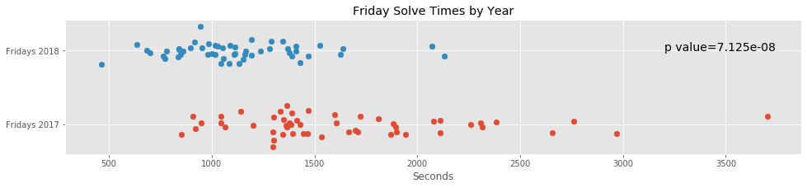
Breaking the Data Down by Day

Slide 8
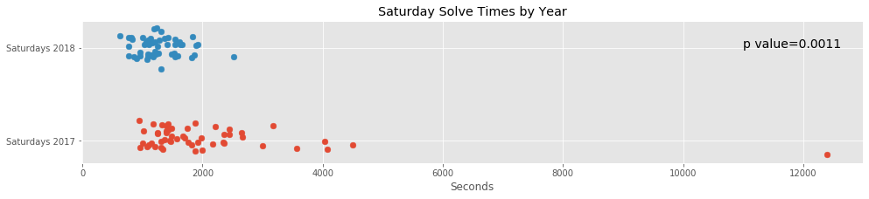
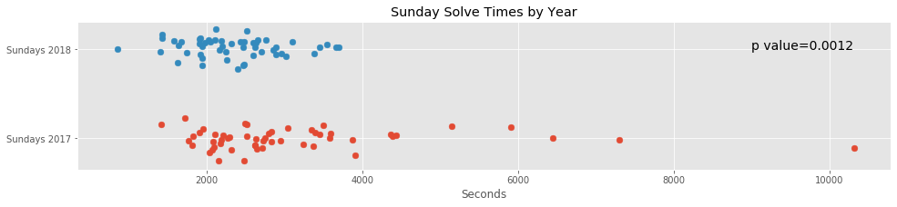
Breaking the Data Down by Day
Notes:
Outliers were when I was dating someone who insisted that we solve some of the puzzles together and he really slowed me down. It didn’t last.

Slide 9
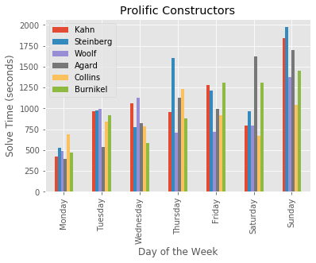
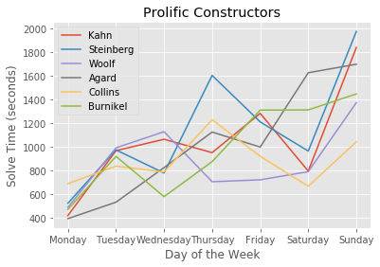
Hit for the Cycle
Notes:
One nerdy bonus slide.
I wanted to look at prolific constructors who had hit for the cycle in the years for which I scraped
Hit for the Cycle – a term borrowed from baseball, it means that a constructor has had at least one puzzle published for each day of the week. Some interesting variation here in the lack of nice smooth upward trends, probably at least partially due to small sample size, but I’ve already started looking into those puzzles on my own time.

Slide 10
What Next?
Question Mark Clues
Thursdays vs. Fridays
Share scraper code
Notes:
Clues that end in question marks indicate a play on words in the clue or answer.
Thursday vs Fridays – I think probably because Thursdays are themed and Fridays are themeless.
Share my scraper code so other nerds can geek out like me.
Additionally – look at rebus puzzles, common crossword-ese like baseball and Yiddish, paired constructor puzzles, puzzles published under pseudonyms, looking more into inconsistencies in hit for the cycle plots.

Slide 11

I didn’t realize I was so obsessed with crosswords, but looking back, I guess the clues were all there...
Kathryn Johnson
Email: kejohnson1231@gmail.com
LinkedIn: https://www.linkedin.com/in/kejohnson1231/
GitHub: https://github.com/kejohnson1231

